Slide 1
Bluehouse Technologies Data Analyst Track
Basics of Statistics for Data Analyst

Slide 2
Basics of Statistics for Data Analysis
Welcome back to the Data Analyst Track! Today, we explore Basic Statistics in Data Analysis.

Slide 3
The Vital Role of Statistics
Statistics is the study of collecting, analyzing, and interpreting data. It provides data professionals with powerful tools and methods to transform data into useful knowledge.
“In data analysis, statistics is the lens through which we make sense of information”

Slide 4
Type of Data
Data
Numerical
Discrete
Continuous
Categorical
2. Categorical data: represents groups or categories. Examples:
Car brands: Audi, BMW and Mercedes.
Answers to yes/no questions: Yes and No
Numerical data represents numbers. It is divided into two groups: discrete and continuous.
- Discrete data can be usually counted in a finite matter, while -- Continuous is infinite and impossible to count. They see measured. Examples:
Discrete: Number of children you want to have, SAT score
Continuous: weight, height

Slide 5
Measurement
Qualitative
Nominal
Ordinal
Quantitative
Levels of Measurement
Interval
Ratio
Nominal: Categories with no order (e.g., seasons: winter, spring, summer, autumn. Gender (Male, Female, Non-Binary), Blood Types (A, B, AB, O)).
Ordinal: Categories with order (e.g., Educational Levels (High School, Bachelor's, Master’s), customer satisfaction ratings (poor, fair, good, excellent). ).
Interval: Measurement with no true zero (e.g., degrees Celsius, Fahrenheit).
Ratio: Measurement with a true zero (e.g., degrees Kelvin, length).
True zero means an absence of the attribute being measured.

Slide 6
Types of Statistics
Descriptive Statistics: Summarizes main features of data.
Uses visuals (graphs, tables) and summary statistics.
Summary statistics include measures of central tendency, dispersion, and position.
Consists of organizing and summarizing the data using visualization plots. Extensively used in Exploratory Data Analysis + Feature Engineering. By using descriptive statistics, we can understand the data.
Example: Histogram, Bar chart, Pie chart, Distribution. What is the average age of students in the classroom? Relation between age and weight?
Inferential Statistics: Draws conclusions and makes predictions about a dataset based on population or sample data.
Conclusion can be made using hypothesis testing consisting of techniques like confidence interval, P-value, Z-test, t test, chi square test, ANOVA (F-test)
Example: University – 500 students (population); Class room A – 60 people (sample); Making conclusion of the average age of the entire university. Are the average age of the students in the classroom less than or greater than the average age of students in university?

Slide 7
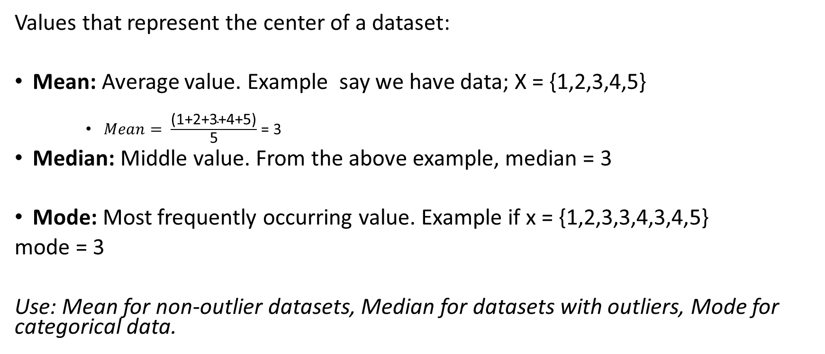
Measures of Central Tendency
Values that represent the center of a dataset:
Mean: Average value. Example say we have data; X = {1,2,3,4,5}
$Mean= \frac{\text{(1+2+3+4+5)}}{\text{5}}$ = 3
Median: Middle value. From the above example, median = 3
Mode: Most frequently occurring value. Example if x = {1,2,3,3,4,3,4,5}
mode = 3
Use: Mean for non-outlier datasets, Median for datasets with outliers, Mode for categorical data.

Slide 8
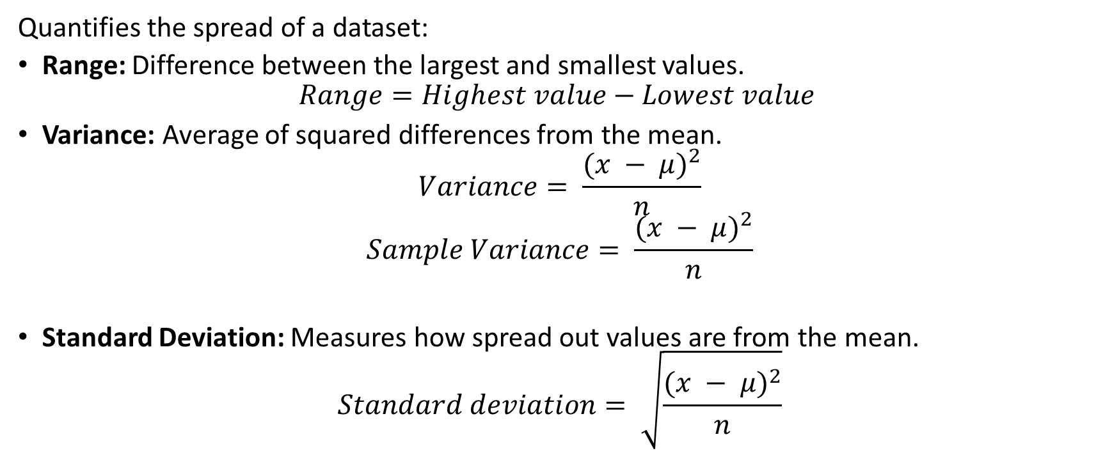
Measures of Dispersion
Quantifies the spread of a dataset:
Range: Difference between the largest and smallest values.
$$Range=Highest value−Lowest value$$
Variance: Average of squared differences from the mean.
$$Variance= \frac{{(x − μ)}^{2}}{n}$$
$$Sample Variance= \frac{{(x − μ)}^{2}}{n}$$
Standard Deviation: Measures how spread out values are from the mean.
$$Standard deviation= \sqrt{\frac{{(x − μ)}^{2}}{n}}$$

Slide 9
Measures of Position
Determines a value's position relative to others:
Percentile: Value below which a percentage of data falls.
Quartile: Divides data into four equal parts.
Interquartile Range (IQR): Range between Q3 and Q1.

Slide 10
Percentile
A percentile is a comparison score between a particular score and the scores of the rest of a group.
It shows the percentage of scores that a particular score surpassed. For example, if you score 75 points on a test, and are ranked in the 85th percentile, it means that the score 75 is higher than 85% of the scores.
-The 25th percentile is also called the first quartile. -The 50th percentile is generally the median -The 75th percentile is also called the third quartile. -The difference between the third and first quartiles is the interquartile range.
The nth percentile is the smallest score that is greater than or equal to a certain percentage of the scores.

Slide 11
Quartile
Example{1,2,2,2,3,3,3,4,5,5,5,6,6,6,6,7, 8,8,9,27}
Lower Fence = Q1 – 1.5*IQR
Higher Fence = Q3 + 1.5*IQR
IQR (Inter Quartile Range) = Q3 – Q1
Q1 = 25/100 * (20+1) = 5.25 index (take average of 5th and 6th index = 3)
Q3 = 75/100 * (20+1) = 15.75 index (take average of 15th and 16th index = 7.5)
IQR = Q3 – Q1 = 7.5 – 3 = 4.5
Lower Fence = 3- (1.5 * 4.5) = -3.65
Higher Fence = 7.5 + (1.5*4.5) = 14.25
Conclusion: Since the lowest value in the dataset of 1, there is no outlier present in the lower fence.
However, 27 is greater than higher fence value 14.25. Hence this can be treated as an outlier and
eliminated from the list.

Slide 12
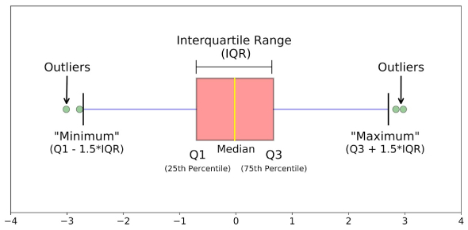
Five Number Summary
Minimum
First Quartile (Q1)
Median
Third Quartile (Q3)
Maximum
The five number summary can be Visualized with a boxplot.

Slide 13
The Vital Role of Statistics II
Welcome back to the Data Analyst Track! Today, we explore basic statistics II (probability)

Slide 14
Probability
The branch of mathematics that deals with measuring and quantifying uncertainty. Describing the likelihood of something happening.

Slide 15
Type of probability
Objective probability: base on statistics, experiment and mathematical measurement.
2. Subjective probability: based on personal feeling, experience or judgement e.g believing a horse will win race, or your club will win a championship not on data but intuition and somehow bias

Slide 16
Probability Distribution
Probability Distribution
Describes the likelihood of the possible outcomes of a random event

Slide 17
Random Variable
Random variable: represent the values for the possible outcomes of a random event which can be categorize as discrete or continuous random variable.
Discrete random variable: has countable number of possible values. This can be counted.
Continuous random variable. Takes all possible values in some range of numbers (measures decimal values no limits to number of possible values)

Slide 18
Discrete probability distribution
A discrete probability distribution that models the probability of events with only two possible outcomes success or failure.
In binomial distribution the assumption is that:
- Each event is independent
- The probability of success is the same for each events
Mutually Exclusive events
Two events are mutually exclusive if they cannot occur at the same time
Poisson Distribution
Models probability that a certain number of events will occur during a specific time period.

Slide 19
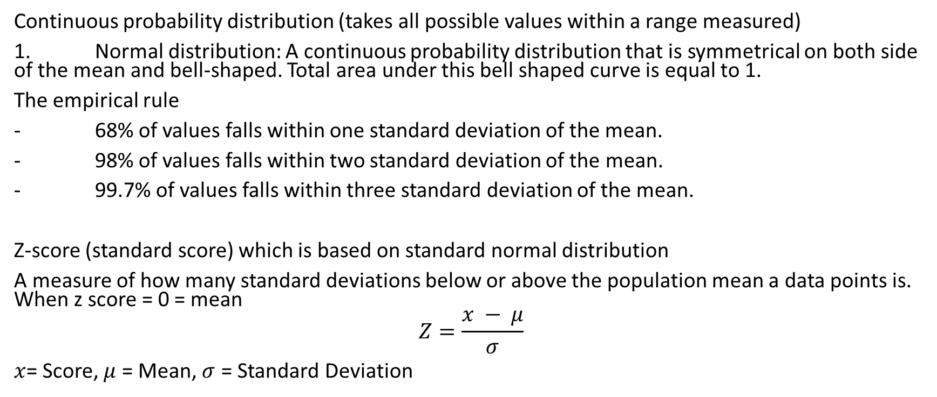
Continuous Probability Distribution
Continuous probability distribution (takes all possible values within a range measured)
1. Normal distribution: A continuous probability distribution that is symmetrical on both side of the mean and bell-shaped. Total area under this bell shaped curve is equal to 1.
The empirical rule
- 68% of values falls within one standard deviation of the mean.
- 98% of values falls within two standard deviation of the mean.
- 99.7% of values falls within three standard deviation of the mean.
Z-score (standard score) which is based on standard normal distribution
A measure of how many standard deviations below or above the population mean a data points is. When z score = 0 = mean
$$Z=\frac{x − μ}{σ}$$
$x$= Score, $μ$ = Mean, $σ$ = Standard Deviation

Slide 20
Sampling
The process of drawing a subset of a data from a population
A good model can’t overcome a bad sample
Quality of sample determines quality of insights
The sampling process
Step 1 identify the target population
Step 2 select the sampling frame i.e. list of every item in a target population specified.
Step 3 choose the sampling method: probability or non probability sampling method
Step 4 determine the sample size: number of individuals for study
Step 5 collect the sample data

Slide 21
Sampling methods
Probability
Non probability sampling
Sample space: is the set of all possible values for a random variable e.g. sample space for a single coin toss = {heads, tails}

Slide 22
Probability sampling method
Simple random sampling method: every member of a population is selected randomly and has an equal chance of being selected or chosen e.g. by random number generator
Stratified random sampling: divide population into groups and randomly select some members from each group to be in the sample e.g. grouping high school student by age.
Cluster random sampling: divide population into clusters and randomly select a certain clusters and include each member from the chosen to the sample e.g. companies with different branch, selecting just a single branch for as a sample for study
Systemic random sampling: put every member of a population, into an ordered sequence, then you choose a random starting point in the sequence and select members for your sample at regular intervals.

Slide 23
Non probability Sampling (does not involve using random selection)
Convenience Sampling: choose members of a population that are easy to contact or reach e.g. opinion poll in high school, sample taken at convenience if home or workplace
Disadvantage: under coverage bias
Voluntary response sampling: members of a population who volunteer, to participate in a study e,g voluntary sample about food in restaurant (response)
Disadvantage: non response bias
Snowball sampling: researchers recruit initial participants to be in a study and then ask them to recruit other participants for the purpose of the study
Disadvantage: unrepresentative of study population
Purposive sampling: researchers select participants based on the purpose of their study
Disadvantage: bias sample

Slide 24
The Vital Role of Statistics III
Welcome back to the Data Analyst Track! Today, we explore inferential statistics

Slide 25
Inferential Statistics
Inferential Statistics is a study where we make assumptions about the population (N) data with the help of sample (n) data and arrive at certain conclusions. In order to validate these assumptions / conclusions, we use HYPOTHESIS TESTING.

Slide 26
Hypothesis Testing
Steps to be performed to carry out hypothesis testing:
Null hypothesis – Ex: A coin is fair
Alternative hypothesis – Ex: A coin is unfair
Perform experimentation –
Example: Toss the coin 100 times. record each result
Let’s say in one case, we got 50 times head and 50 times tail.
We can conclude that this is a fair coin.
Consider another scenario where we got 60 times head and 40 times tail.
We can still agree that the coin is fair.
But what if we got 75 times head and 25 times tail???
We might tend to disagree with the null hypothesis which states the coin is fair.
In every situation, the range of acceptable outcomes will change and this range is called CONFIDENCE INTERVAL.
Conclusion – If the outcome is within the confidence interval, then we fail to reject the null hypothesis. Else we can say null hypothesis is rejected.

Slide 27
Point Estimate ()
The value of any statistics (sample mean x ) that estimates the value of a parameter (population mean µ) is called point estimate.

Slide 28
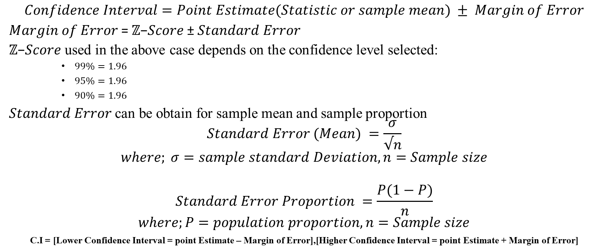
Finding confidence Interval
$$Confidence Interval=Point Estimate(Statistic or sample mean) ± Margin of Error$$
𝑀𝑎𝑟𝑔𝑖𝑛 𝑜𝑓 𝐸𝑟𝑟𝑜𝑟 = ℤ−𝑆𝑐𝑜𝑟𝑒 ± $Standard$ 𝐸𝑟𝑟𝑜𝑟
ℤ−𝑆𝑐𝑜𝑟𝑒 used in the above case depends on the confidence level selected:
$99\%=1.96$
$95\%=1.96$
$90\%=1.96$
$Standard$ 𝐸𝑟𝑟𝑜𝑟 can be obtain for sample mean and sample proportion
$$Standard Error (Mean) =\frac{σ}{√n}$$
$$where; σ=sample standard Deviation, n=Sample size$$
$$Standard Error Proportion =\frac{P(1−P)}{n}$$
$$where;P=population proportion, n=Sample size$$
C.I = [Lower Confidence Interval = point Estimate – Margin of Error],[Higher Confidence Interval = point Estimate + Margin of Error]

Slide 29
Problem Statement
On the quant test of CAT exam, a sample of 25 students has a mean of 520 with a population standard deviation of 100. Construct a 95% CI about the mean.
Solution
n= 5 sample mean (x) = 5 σ = 1 CI = 95%
Significance Value (SV) = 1 – Confidence level = 1 - 0.95 = 0.05
Lower CI = Point estimate – Margin of error
Higher CI = Point estimate + Margin of error
Lower CI = 520 – 1.96*(20) = 520 – 39.2 = 480.8
Similarly;
Higher Confidence Interval = 520 + 1.96*(20) = 520 + 39.2 = 559.2
Conclusion:
Since the sample mean 520 is within the range of confidence interval ranging between [480.8, 559.2]. we fail to reject the null hypothesis.

Slide 30
Confidence Interval
A range of value that describes the uncertainty surrounding an estimate
Point Estimate: uses a single value to estimate a population parameter
Interval Estimate: uses a range of value to estimate a population parameter
Margin of Error: the maximum expected difference between a population parameter and a sample estimate
Margin of Error = Z-Score × Standard Error

Slide 31
Confidence Level
Confidence Level: describe the likelihood that a particular sampling method will produce a confidence interval that includes the population parameter
Technically it means 95% of the population parameter will be contain in the interval
Sales Revenue Forecasting example:
“I think we will do $1,000,000 in sales” : Point Estimate
“Based on a 95% confidence level, I estimate that our sales revenue will be between $950,000 and $1,500,000” : Confidence Level and Interval Estimate

Slide 32
Confidence Interval (Interpretation)
95% of interval capture the population mean
5% of the interval do not capture the population mean
95% of the total will capture the population mean
95% of the random interval generated to capture the population parameter

Slide 33
Steps for constructing confidence interval with example
Identify a sample statistic: e.g. 50 (mean), 55% (proportion)
Choose a confidence level: 95%
Find margin of error = z score * standard error
(note: confidence level has it z score).
Recall to find margin of error: first find the standard error, then multiply by corresponding z score of the chosen confidence level
Calculate interval = [(sample statistic – margin of error), (sample statistic + margin of error)]
As the sample size gets larger the confidence interval gets narrower
Example:
when sample size is 100 confidence interval [45.2, 64.8]= 19.6
When it is 1,000 [50.9, 57.1] = 6.2
From the above example as it has shown that the sample size gets larger the confidence interval gets narrower
As sample size increases the margin of error decreases.
Sampling entire population results to zero margin of error
As the confidence level gets higher (e.g. from 95% to 99%) the confidence interval gets wider.

Slide 34
Hypothesis Testing
Hypothesis Testing
A statistical procedure that uses sample data to evaluate an assumption about a population parameter
Statistical significance
The claim that the results of a test or experiment are not explainable by chance alone.

Slide 35
Steps for Performing a Hypothesis Test
1. State the null hypothesis and the alternate hypothesis
2. Choose a significance level
3. Find the p value
4. Reject or fail to reject the null hypothesis
Null hypothesis: a statement that is assumed to be true unless there is a convincing evidence to the contrary
Alternate hypothesis: is a statement that contradicts the null hypothesis and is accepted as true only if there is a convincing evidence for it.

Slide 36
Definitions
Significance level: the probability of rejecting the null hypothesis when it is true
P value: the probability of observing results as or more extreme than those observed when the null hypothesis is true.
“A lower p value means there is stronger evidence for the alternate hypothesis”
Drawing a conclusion
If p value < significance level: reject the null hypothesis
If p value > significance level: fail to reject the null hypothesis

Slide 37
Types of error in hypothesis testing
Type 1 error (false positive): the rejection of a null hypothesis that is actually true
Type 2 error (false negative): The failure to reject a null hypothesis which is actually false
Choosing a lower significance level increases chances of type 2 error (false negative) i.e failure to reject a null hypothesis which is actually false
To minimize the risk of type 1 error, choose a significance of level 1%
One sampled test
Determines whether or not a population parameter like a mean or proportion is equal to a specific value
Two sample test
Determines whether or not a population parameter such as two means or two proportion are equal to each other
Test statistic
A value that shows how closely your observed data matches the distribution expected under the null hypothesis
Z test: when population standard deviation is known
T test: when standard deviation is unknown and needs to be estimated from data

